Slide 1
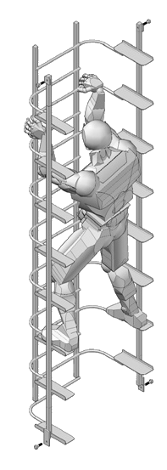
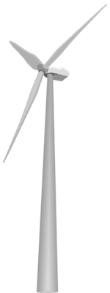

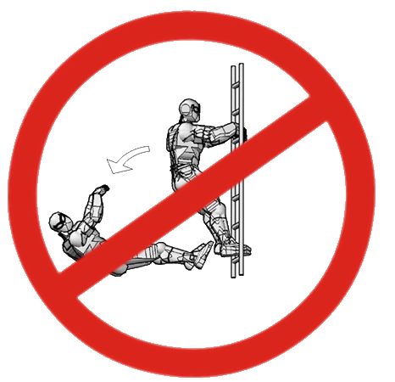
VERTICAL STAIRWAY
New vertical ladder technology
That solves major safety and ergonomic problems
For climbers of millions of tall structures
www.vertical-stairway.com
1

Slide 2
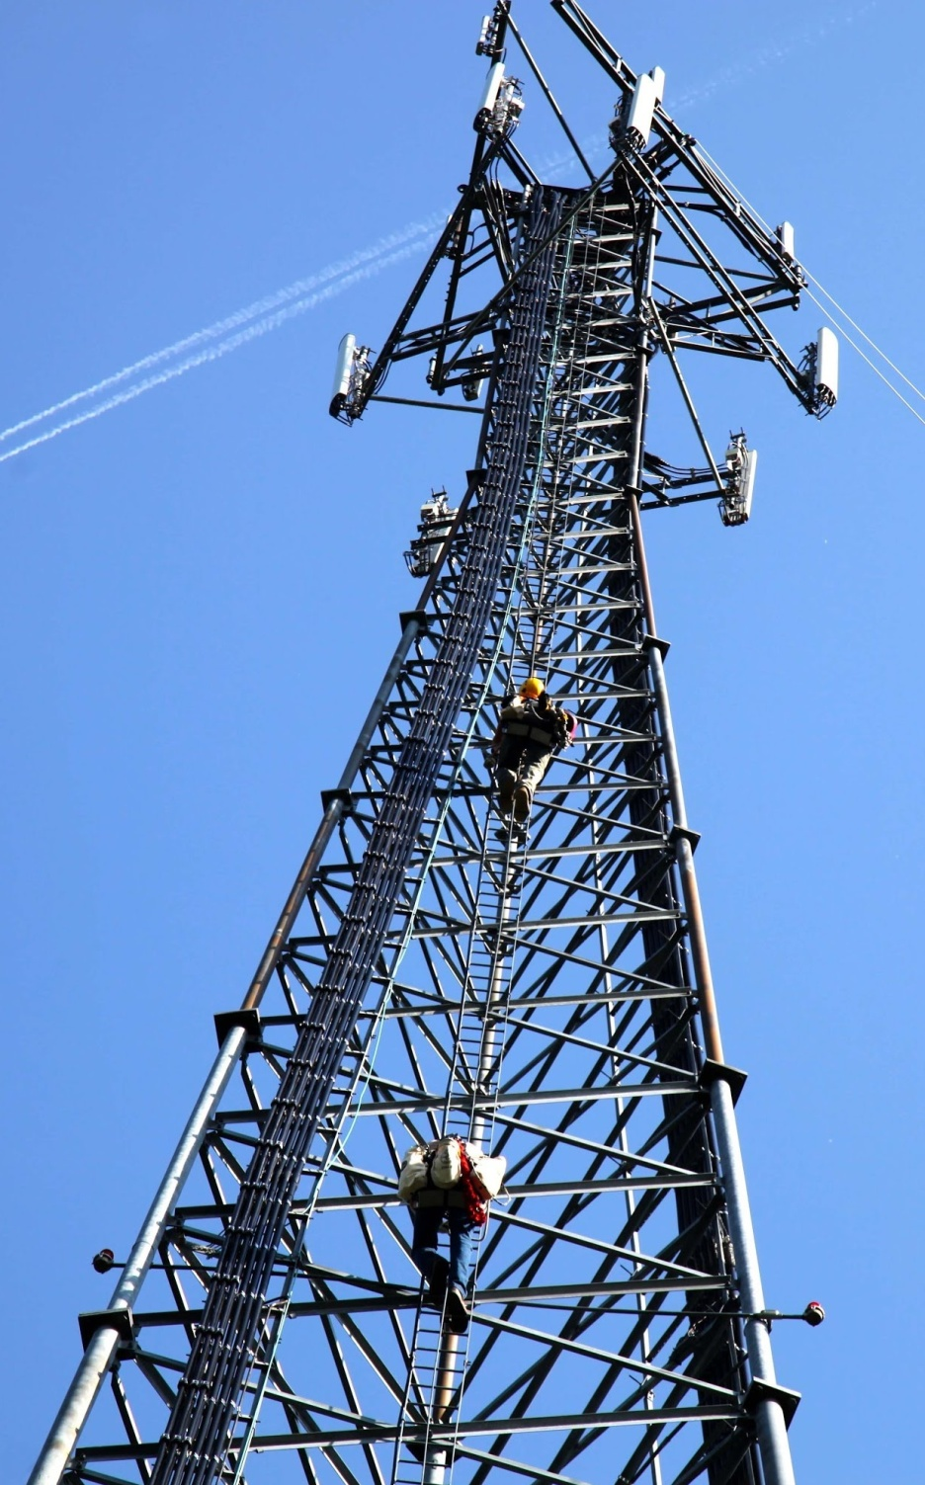
THERE ARE TENS OF MILLIONS OF LONG VERTICAL LADDERS AROUND THE WORLD.
Some are climbed regularly by operators of Tower Cranes; and maintenance workers on cell phone towers and wind turbine towers.
Some are climbed only occasionally – for example fire escapes.
They are often “caged ladders” with rest platforms.
www.vertical-stairway.com
2

Slide 3
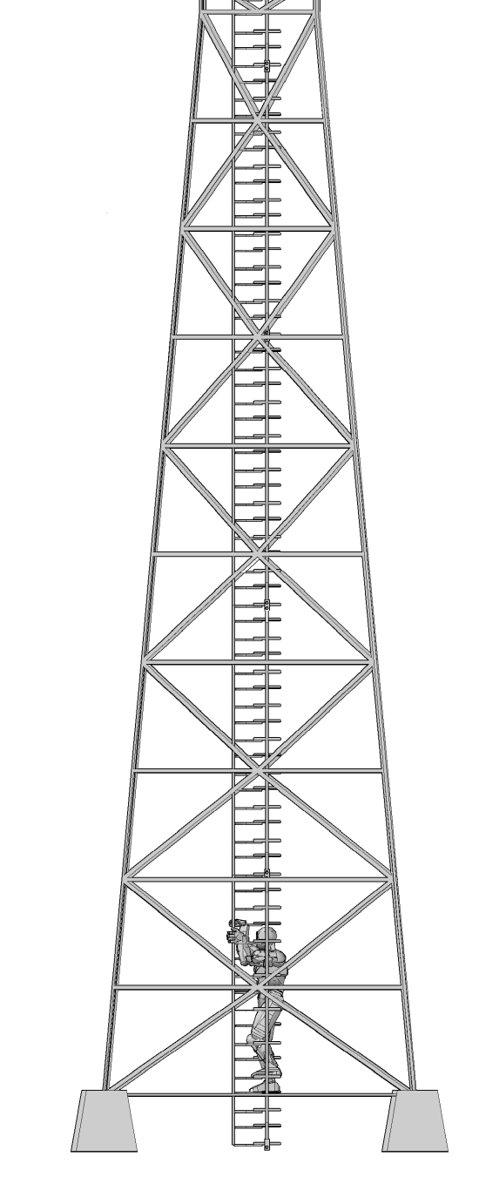
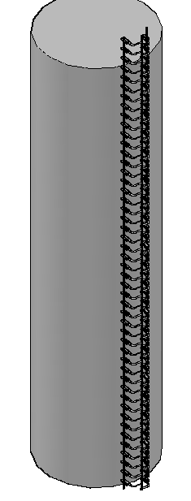
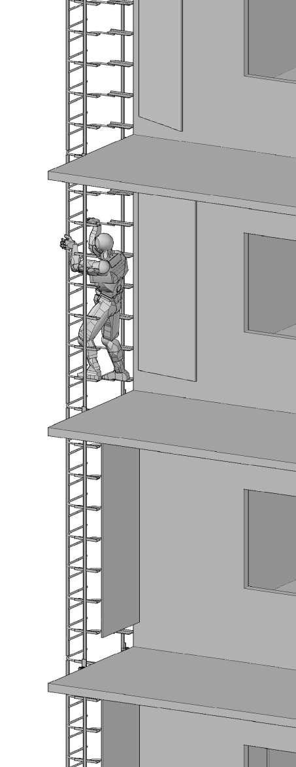
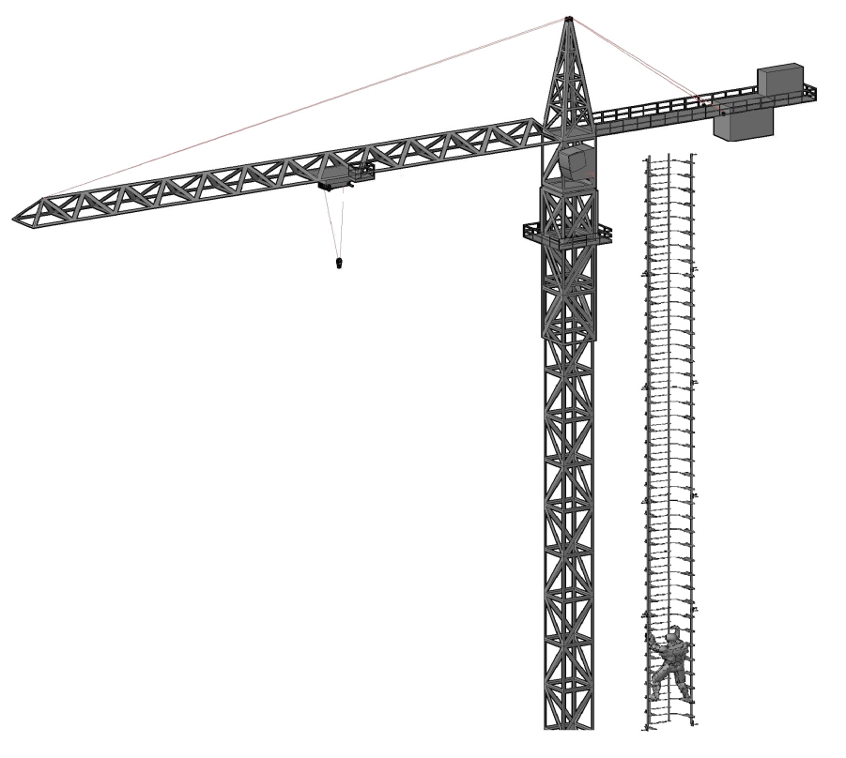
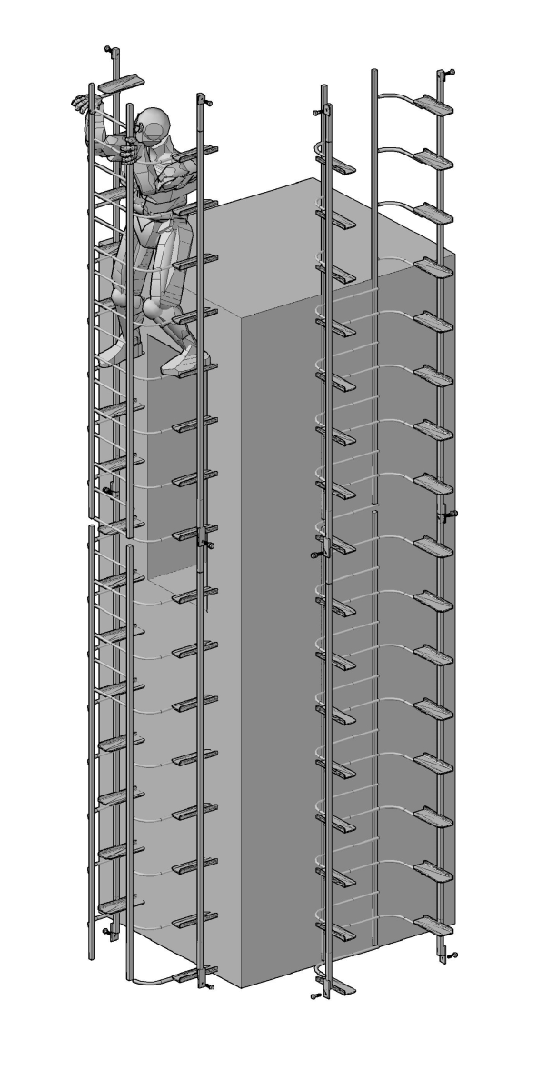
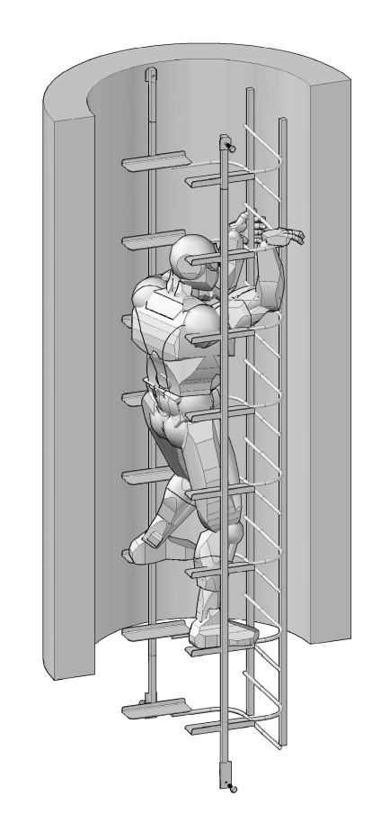
SOME EXAMPLES
WIND TURBINES
ROOF ACCESS
WATER TOWERS & SILOS
TOWER CRANES
TELECOM TOWERS
FIRE ESCAPES
MANHOLES
www.vertical-stairway.com

Slide 4
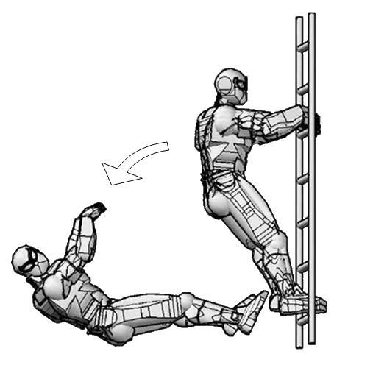
PROBLEMS WITH LONG VERTICAL LADDERS
  DANGER - THE CLIMBER FALLS OFF IF HE LETS GO WITH HIS HANDS!
  Gravity forces the climber to fall away from conventional ladders - he rotates backwards around the fulcrum of his feet.
  FATIGUE – CLIMBING IS STRENUOUS AND UNSUSTAINABLE.
  Half of the work is done by the legs. The weaker arms - must do the other half. It’s like doing “chin ups” – and is unsustainable.
    ACCESSABILITY
    Climbers should be young & physically fit. People that are old; overweight; unfit; and injured or disabled – maybe incapable of making a climb.
    This might require a skilled worker [like a crane operator] to retire early. It could be fatal if the ladder was a fire escape.
4
www.vertical-stairway.com

Slide 5
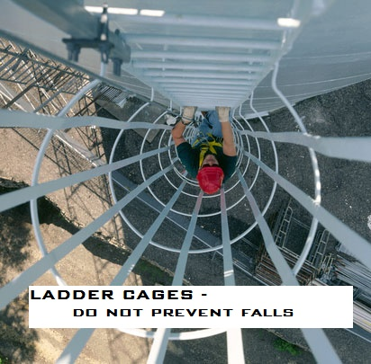
A NOTE ABOUT LADDER CAGES…
CAGES ARE WIDELY CRITICIZED – and of questionable value…
…a leftover from the days when they were used on ship masts to counter rolling seas & strong winds.
CAGES DO NOT PREVENT FALLS
CAGES DO NOT ARREST A FALLING PERSON
CAGES PROVIDE ONLY PSYCHOLOGICAL COMFORT
and the appearance of trying to do something about the danger of falling.
MANY ARGUE THAT CAGES PROVIDE A FALSE SENSE OF SECURITY
that actually increases the number of accidental falls.
CAGES HAVE HINDERED RESCUERS AFTER FALLS
www.vertical-stairway.com
5

Slide 6
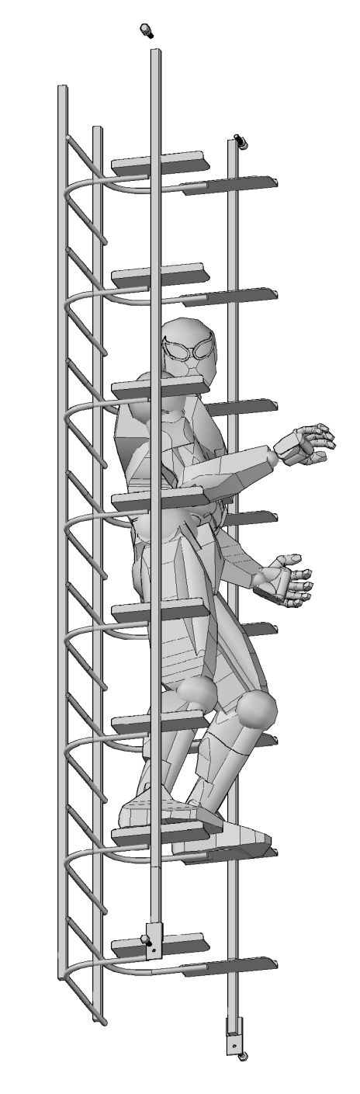
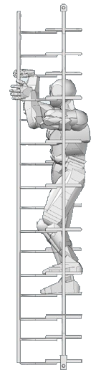
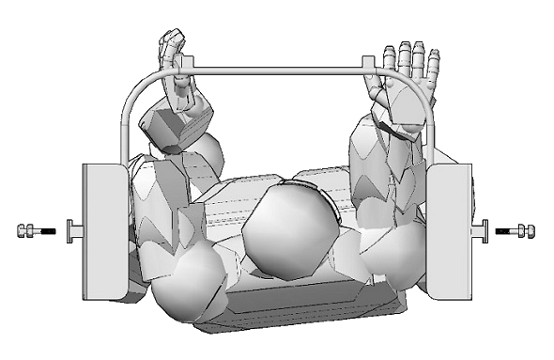
SOLUTIONS WITH VERTICAL STAIRS
  SAFETY IS INCREASED
  The climber doesn’t fall off if he lets go with his hands!
  FATIGUE IS GREATLY REDUCED
The load on the arms is transferred to the legs.
Like climbing stairs … not like doing chin-ups.
ENABLES – OLDER, UNFIT, OVERWEIGHT, OR INJURED CLIMBERS
  Increases working life for skilled staff.
  Ideal for Fire Escape Ladders.
A FULLY SUPPORTED CENTRE OF GRAVITY
www.vertical-stairway.com

Slide 7
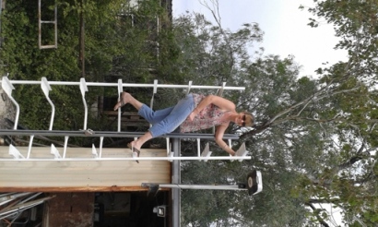
ADDITIONAL ADVANTAGES OF VERTICAL STAIRS
SAFELY ACCESS CONFINED SPACES – LIKE MINESHAFTS
Where there is no room for rest platforms
REST PLATFORMS MAY NOT BE NECESSARY
  Every pair of steps is a “rest platform”. Climbers can even turn sideways and sit on a step! Platforms are expensive; and may be unnecessary or infrequent on Vertical Stairs* - reducing cost.
VERTICAL STAIRS ARE IDEAL FOR USE WITH FALL ARREST SYSTEMS
Fall arrest rails or cables would be uninterrupted by rest platforms.
REDUCED CLIMBING TIME
Less effort needed- means reduced climbing time for maintenance workers.
INSURANCE PREMIUMS MAY BE CHEAPER **
The increased safety of Vertical Stairs should be reflected by a decrease in work-cover premiums – and also reduced payouts by way of decreased numbers of accidents.
[*this has yet to be tested and approved by standards authorities]
[** a good argument – yet to be proven]
www.vertical-stairway.com

Slide 8
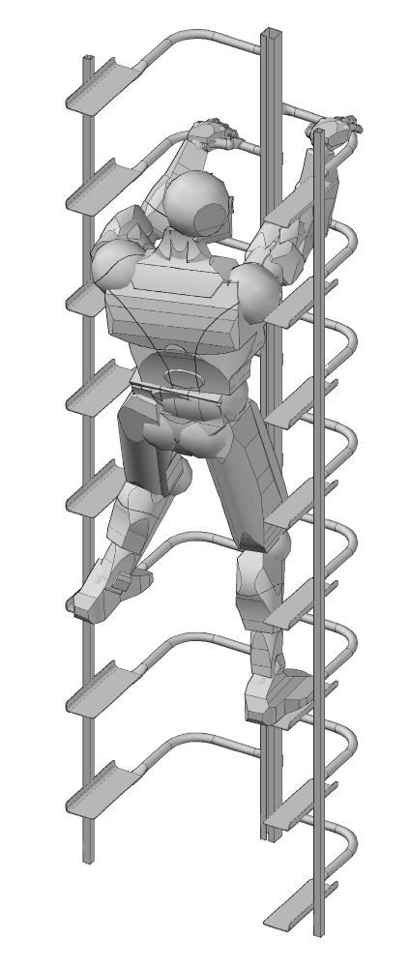
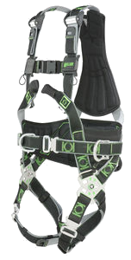
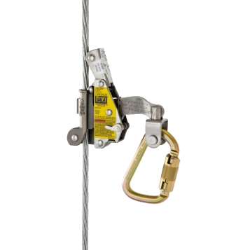
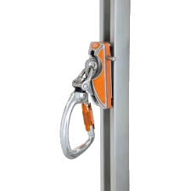

THE BEST POSSIBLE SYSTEM
Harness & fall arrest devices are now standards for working at heights.
The addition of Vertical Stairs will provide the safest & easiest possible system for long vertical climbs.
www.vertical-stairway.com

Slide 9
MAJOR SAFETY PROBLEM
UNIQUE PATENTED SOLUTION
CONVENTIONAL LADDERS
Demand for Vertical Stairs will be driven by:
OH&S REGULATORS – must legislate in favour of safer technology
LADDER CLIMBERS – finding it easier to use Stairs than ladders
EMPLOYERS – not wanting to be sued by a falling climber
PRICE - cheaper than caged ladders with rest platforms & fire stairs*
[*preliminary estimates ]
VERTICAL STAIRS
www.vertical-stairway.com

Slide 10
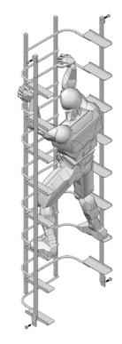
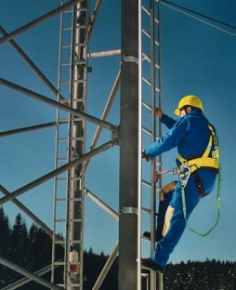
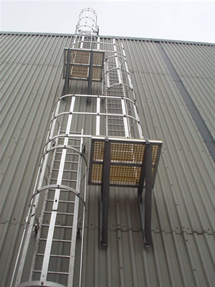
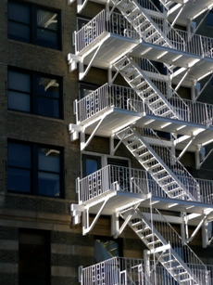


COMPETITOR ANALYSIS
 | VERTICAL STAIRS | VERTICAL LADDERS | VERTICAL LADDERS - with cages & platforms | STAIRS & LANDINGS
SAFE - for fit climbers
ACCESSIBLE - for older unfit climbers
EASY TO USE
LOWER COST
CONFINED SPACES
www.vertical-stairway.com

Slide 11
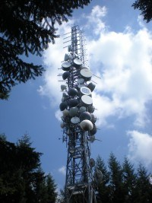
MARKET ANALYSIS & OPPORTUNITY
THE TARGET MARKETS
 The large established global market for long fixed vertical ladders – for example
cell-phone towers;
 Part of the market for fire escapes.
MARKET SIZE
There are tens of millions of long fixed vertical ladders around the world.
Domestically – the Australian market – about 200,000 ladders.
MARKET VALUE – GLOBAL
Estimated value of the existing global ladder infrastructure is $100billion.
Estimated annual growth of $5billion.
[…”in 2014 ‘China Tower’ had 3.3m base stations…China Tower is expected to build more than one million towers over the next two years”…]
www.vertical-stairway.com
MARKET ANALYSIS & OPPORTUNITY

Slide 12


INTELLECTUAL PROPERTY
VERTICAL STAIRWAY is patentable & patent pending.
  Searches of international patent databases by IP Australia & WIPO have been completed; and a written opinion as to patentability has been issued.
  Provisional patent protection is in place & a PCT [Patent Cooperation Treaty] application has been lodged.
  National Phase patent applications will be lodged over the next 12 months. It is hoped that full 20 year patent protection will be obtained in approximately 20 countries.
Australian & International Patents Pending IP # 2014905077 & # 2015900904 - PCT/AU2015/050749 - Australian Registered Design # 16062/2015
www.vertical-stairway.com

Slide 13
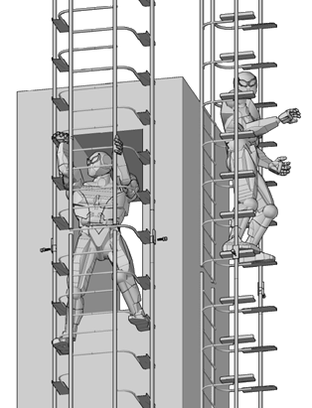
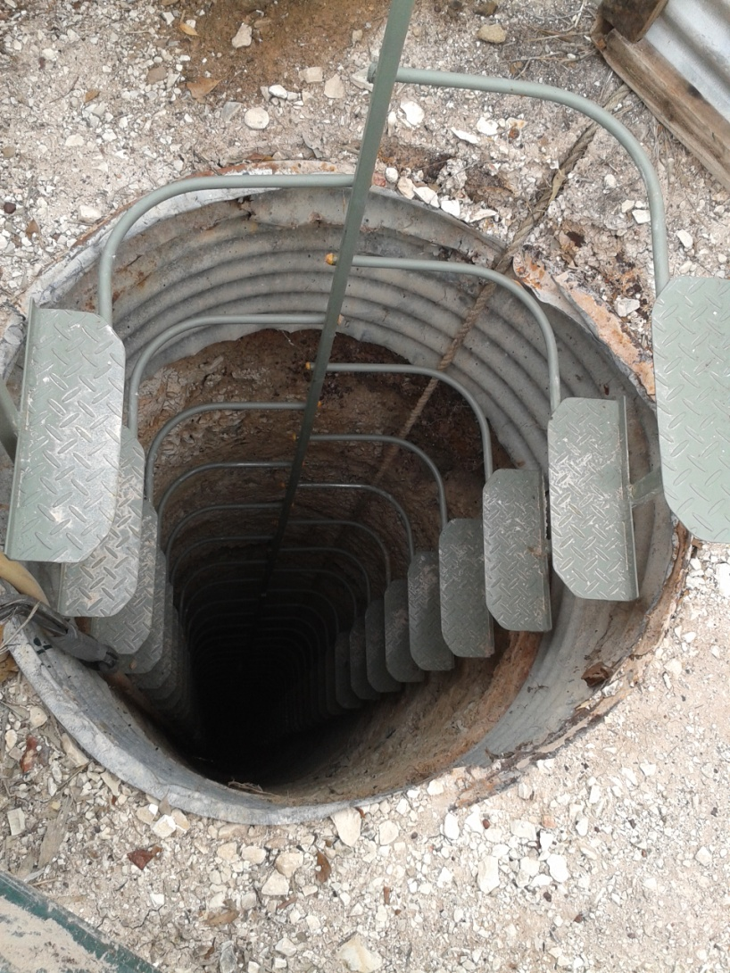
GALLERY
[Left] – Vertical stairs used in a 60 foot opal mine shaft in Lightning Ridge. Elderly ladies have made this climb – and described it as “easy”. I have “walked up it” without using my hands [GR].
[Right] – Two different mountings on a wall. The climber on the left has his “cage”. The climber on the right would be facing the wall and holding the rungs in normal use.
www.vertical-stairway.com

Slide 14
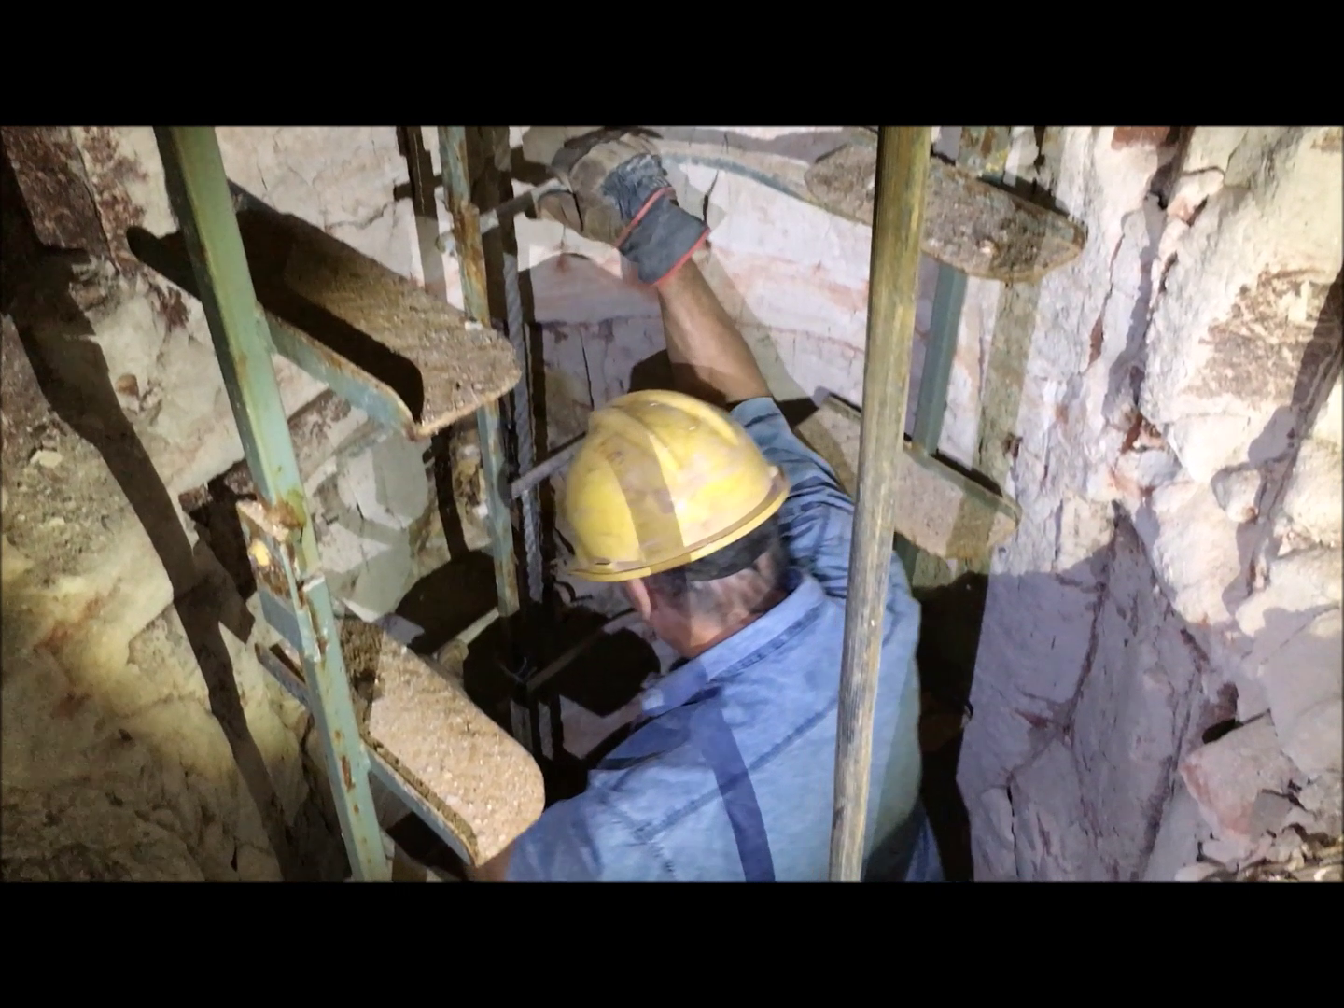
GALLERY
WORKING LADDERS
Vertical Stairs being used in an opal mine.
“Everybody in the Ridge wants a set of these ladders!”
www.vertical-stairway.com

Slide 15
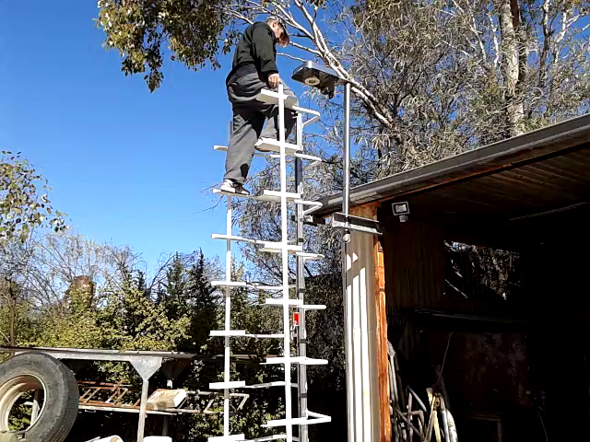
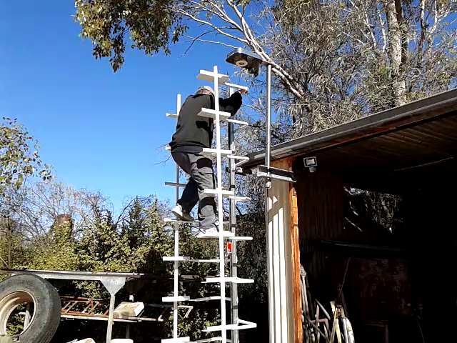
GALLERY
A prototype with a fall arrest rail inbuilt as the front ladder stile. The red “rail glider” can just be seen.
www.vertical-stairway.com

Slide 16
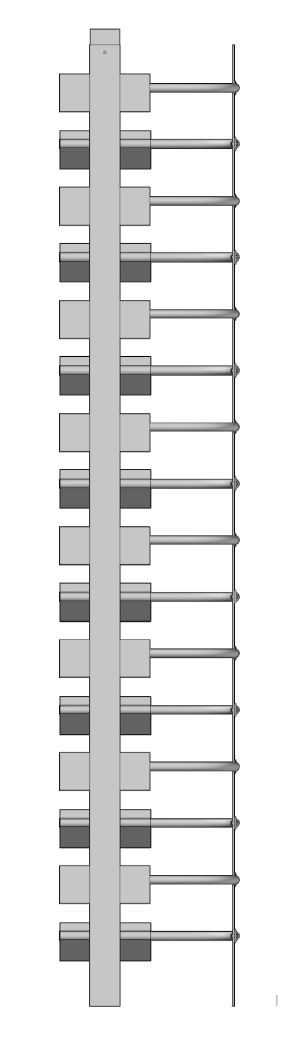
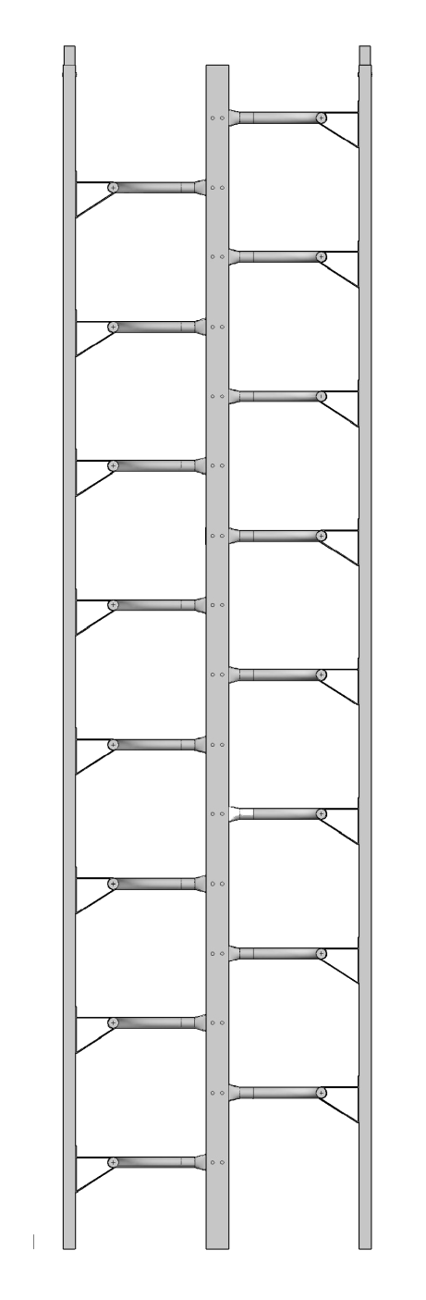
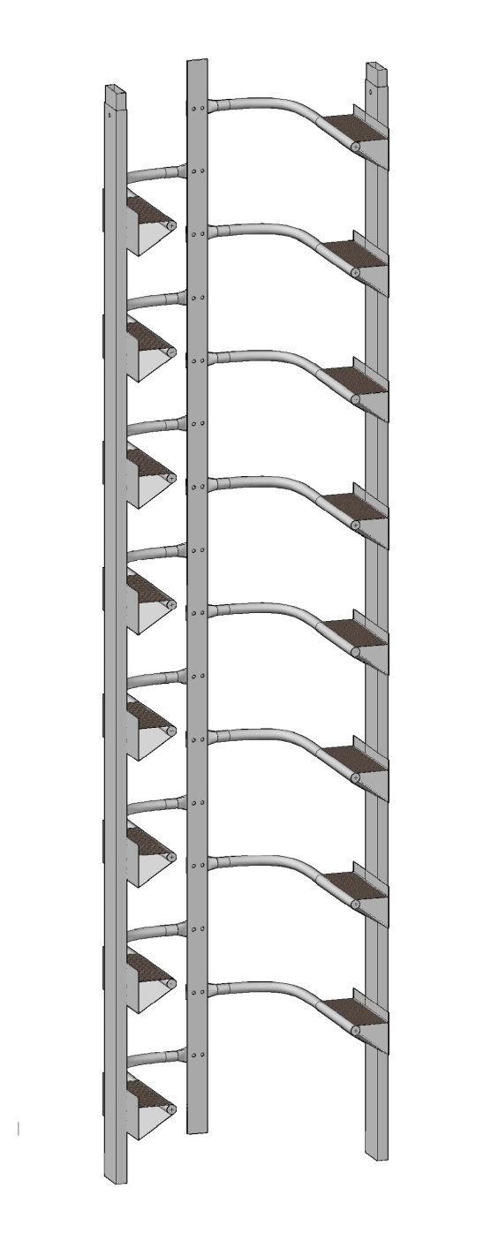
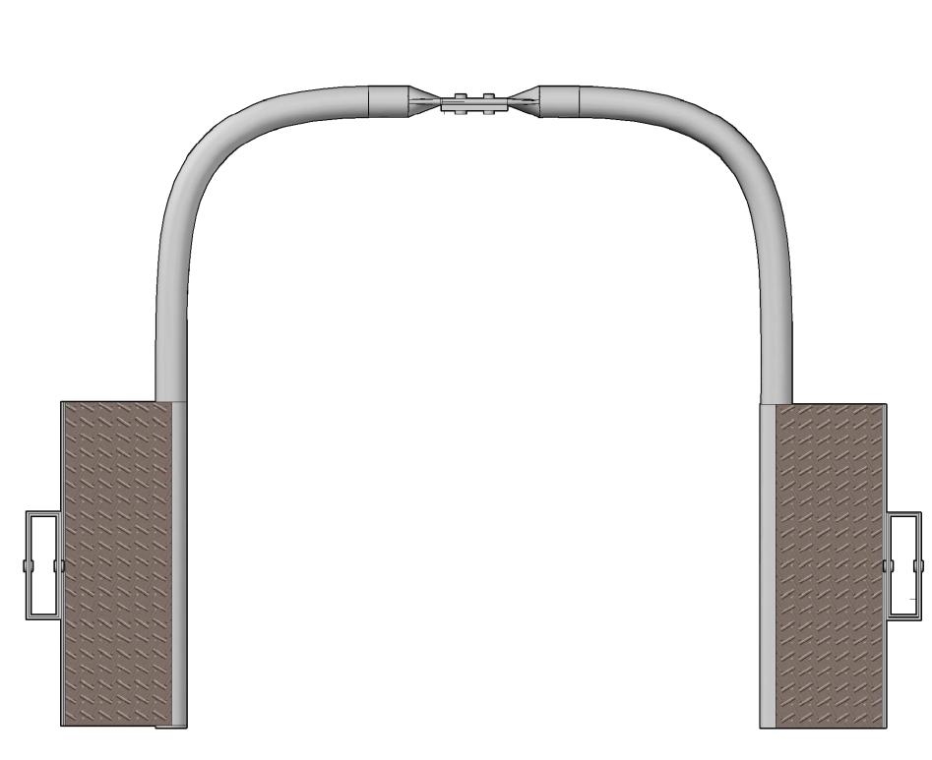
GALLERY
Top, side, front and angled views of an aluminium model. Note the triangular extrusion profile of the steps.
www.vertical-stairway.com

Slide 17
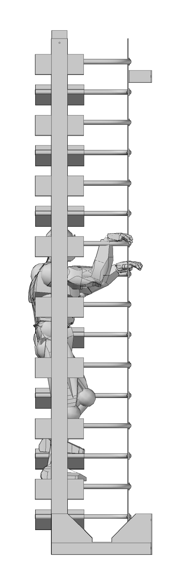
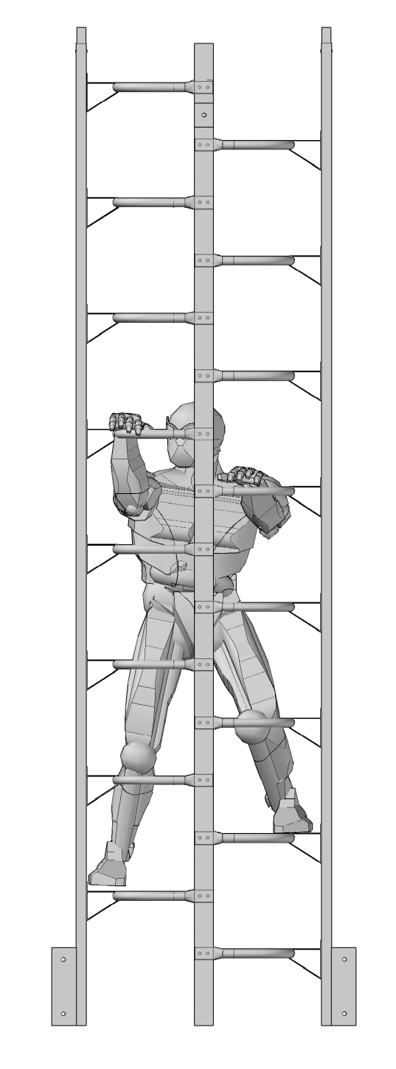
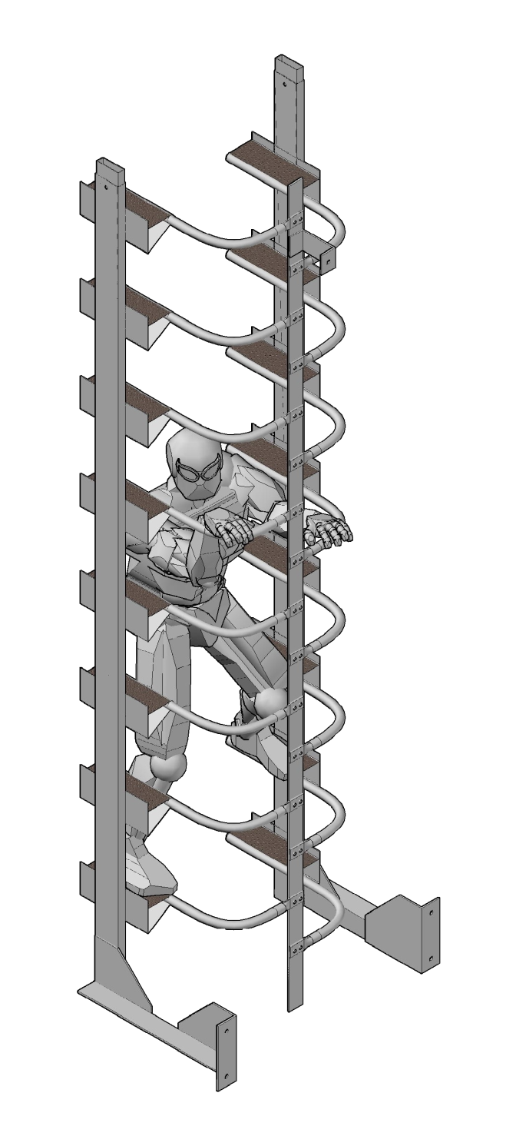
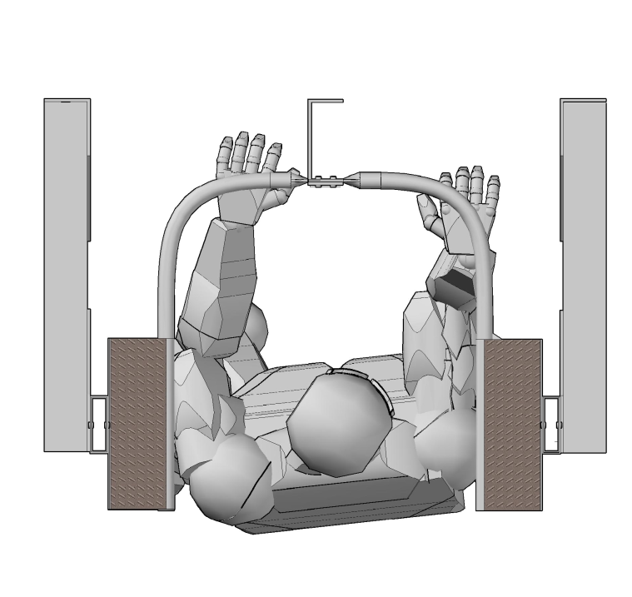
GALLERY
Notes
Distance between steps should be wider in this drawing.
Brackets may likely be facing backwards to a wall; and shorter.
www.vertical-stairway.com

Slide 18
REFERENCES:
“Falls from heights are a major cause of death and injury in Australian workplaces, according to Safe Work Australia. “
http://www.safeworkaustralia.gov.au/sites/swa/about/publications/pages/work-related-injuries-fatalities-involving-fall-from-height-australia
“Caged ladders - a case of mistaken identity”
http://www.safetysolutions.net.au/content/height/article/caged-ladders-a-case-of-mistaken-identity-1399181218
Telecom Towers - “China Tower readies for action, targets 1M towers in 2 years”
http://www.mobileworldlive.com/asia/asia-news/china-tower-readies-action-targets-1m-towers-2-years/
Global wind energy production increased 44% last year!
http://inhabitat.com/winds-of-change-global-wind-energy-production-nearly-doubled-in-2014/
Wind Towers – Global report 2014 – “Denmark get’s 39% of its electricity from wind”
http://www.gwec.net/wp-content/uploads/2015/03/GWEC_Global_Wind_2014_Report_LR.pdf
Global Wind in numbers 2014
http://www.gwec.net/global-figures/wind-in-numbers/
2015 – US has 50,000 wind towers
http://inhabitat.com/the-u-s-now-has-50000-wind-turbines-fighting-climate-change/
www.vertical-stairway.com

Slide 19
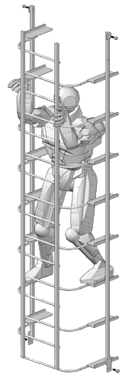
CONTACT INFORMATION:
www.vertical-stairway.com
GLENN RODDENBY – PO Box 1035, Lightning Ridge, NSW 2834
02 6829 2917 0488 0655 02 glenn_roddenby@bigpond.com
www.vertical-stairway.com

